Slide 1

Channeling Hygieia: A Graphical Guide to Attaining Healthy Living
Senior Project
Yessica Rodriguez
Supervisor: Dr. Mahmoud K. Quweider
Fall 2018

Slide 2

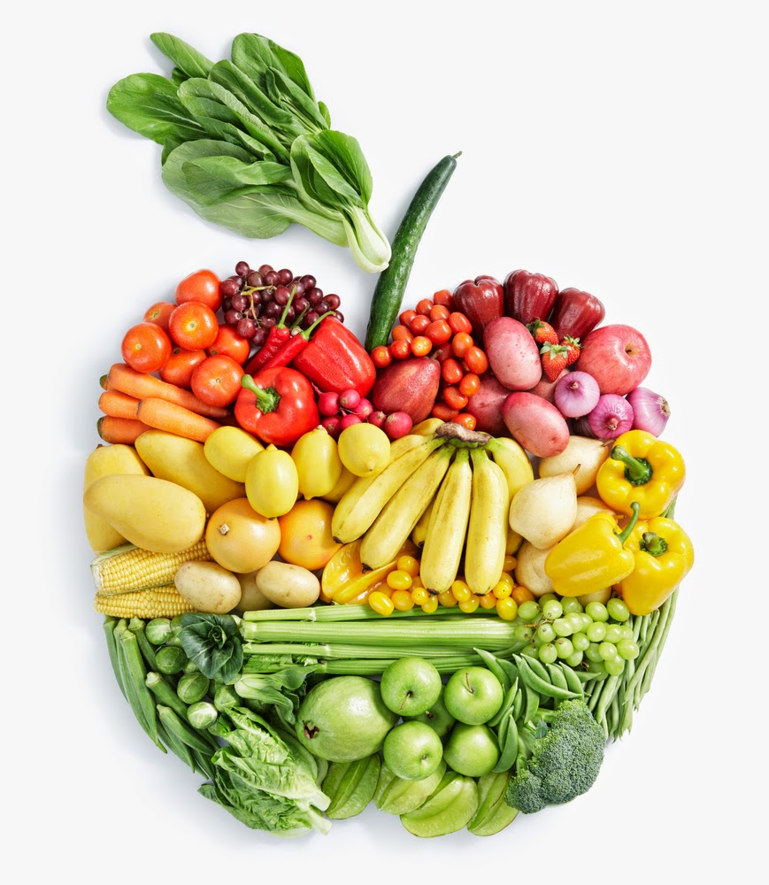


Project overview
Graphical User Interface (GUI) that is JavaFX-based
Allows user to create an account
Provide nutritional Information
Provide exercise Information
Provide dietary and exercise recommendations based on entered user information
MySQL database

Slide 3

Model-view-controller (Mvc) MODEL

Slide 4
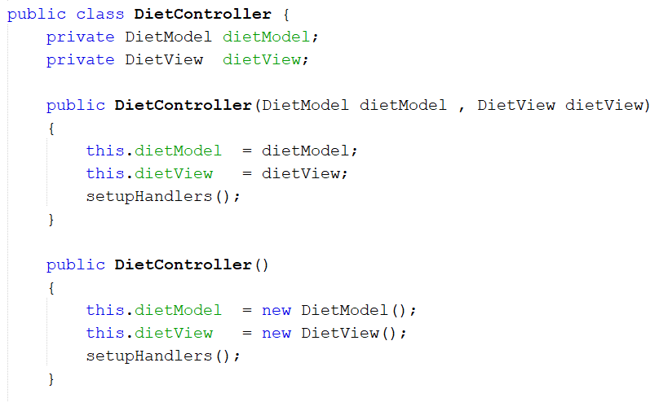
Code snippets

Slide 5
Application (cont.)
Profile
Sign-In
Profile Information
Recommendations
Diet
Food Information
Calorie Calculator
Exercise
Exercise Information
Additional Information
List of Websites with more Information

Slide 6
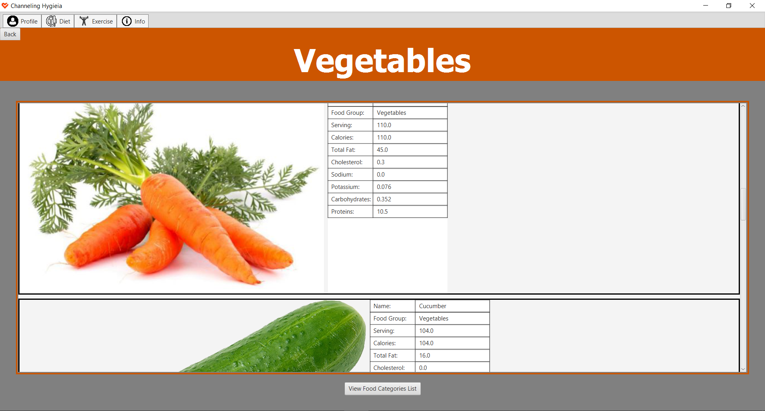
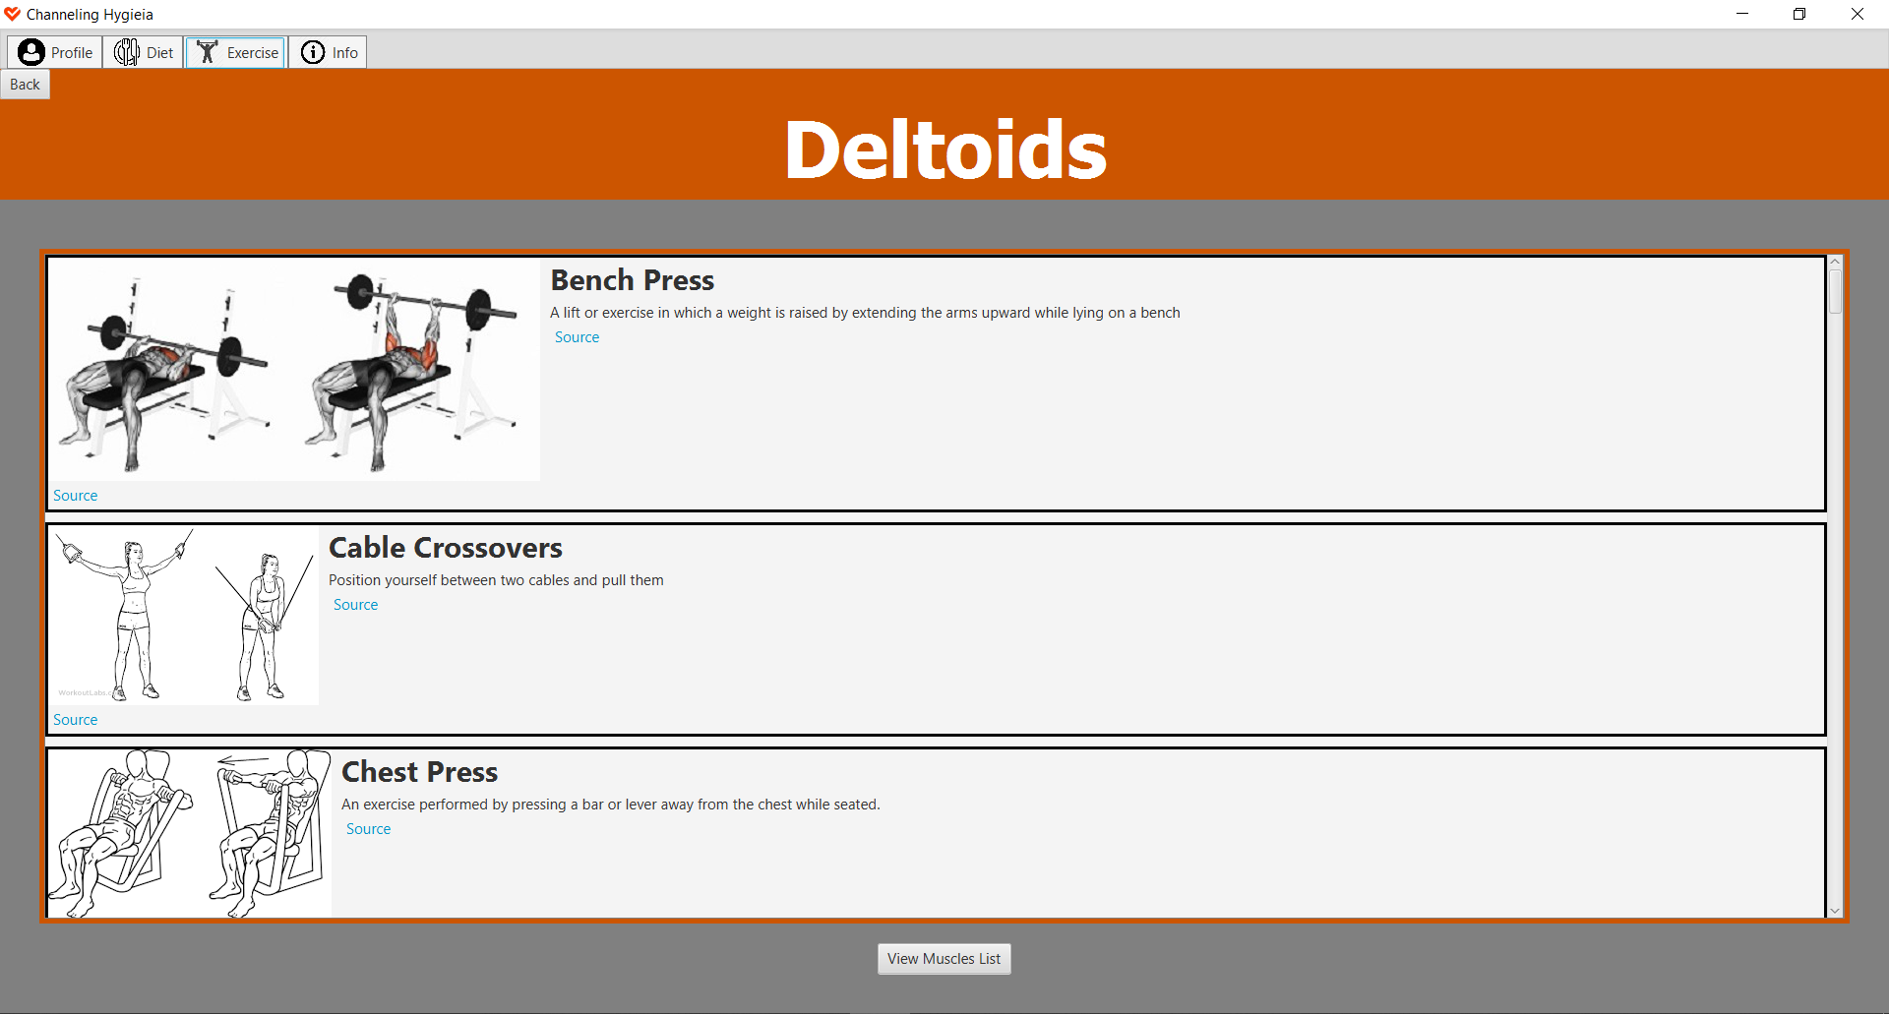
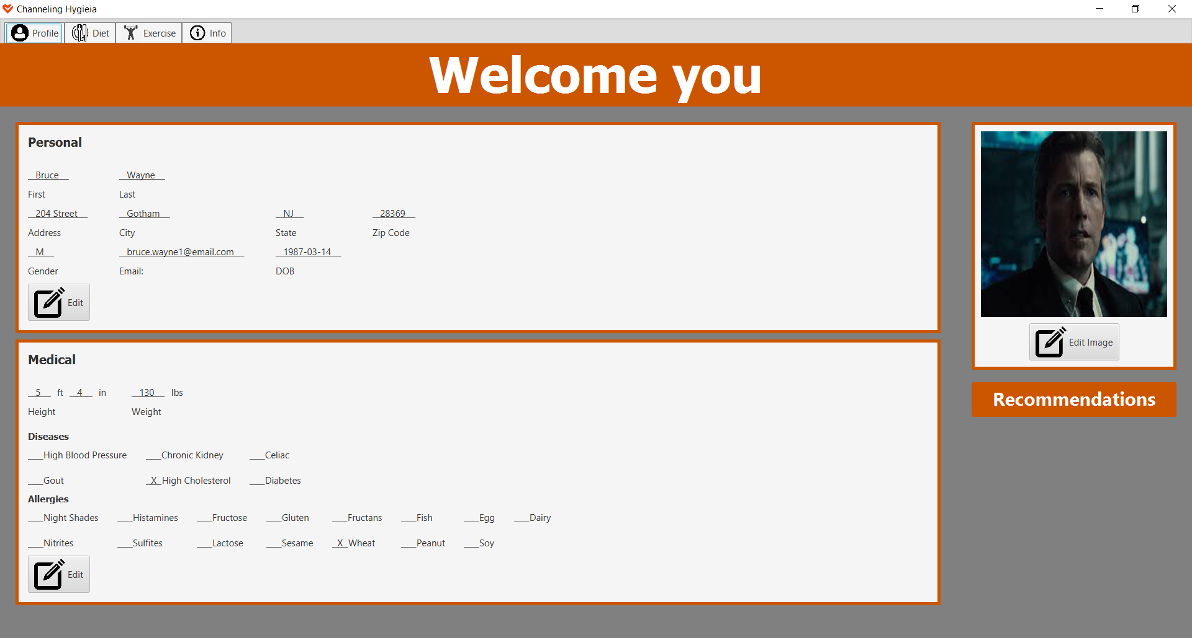
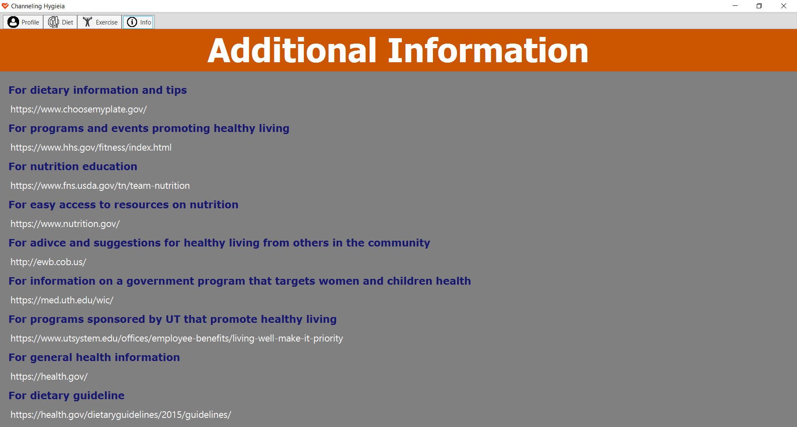
Application (cont.)

Slide 7
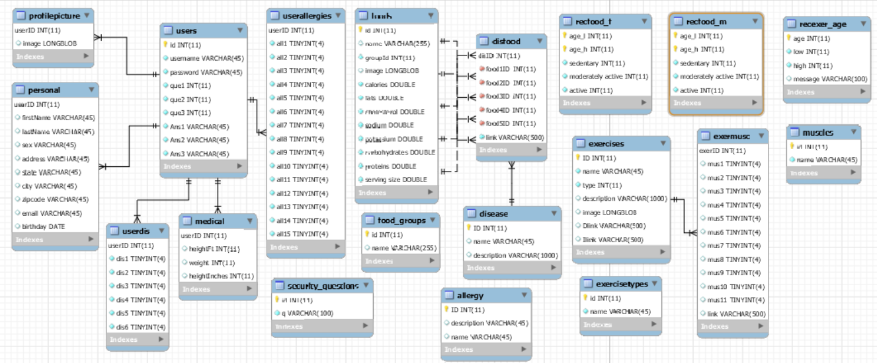
Database

Slide 8
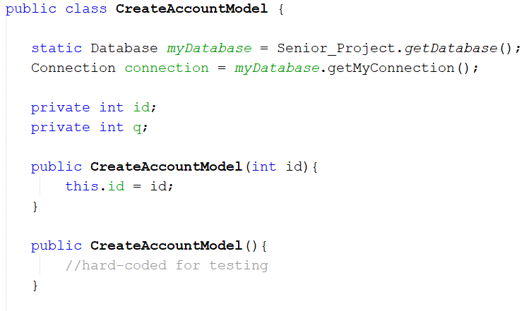
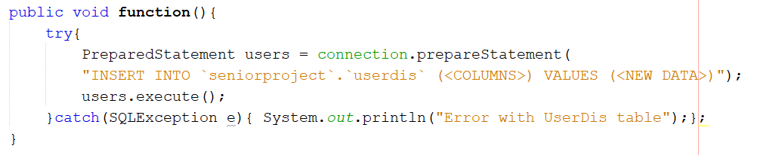
Code snippets
public class Model {
static Database myDatabase = Senior_Project.getDatabase();
Connection connection = myDatabase.getMyConnection();
String state = "SELECT * FROM seniorproject.TableName WHERE id = ‘”;
...
public function(Parameters) {
try (PreparedStatement statement = connection.prepareStatement(state + id + "'"))
{
try (ResultSet set = statement.executeQuery())
{
while(set.next()){
VARAIABLE = (set.getString("COLUMN NAME"));
VARAIABLE = (set.getInt("COLUMN NAME"));
VARAIABLE = (set.getBoolean("COLUMN NAME"));
...
}
}
}catch(SQLException e){
System.out.println(“Not in the database");
};
}
...

Slide 9
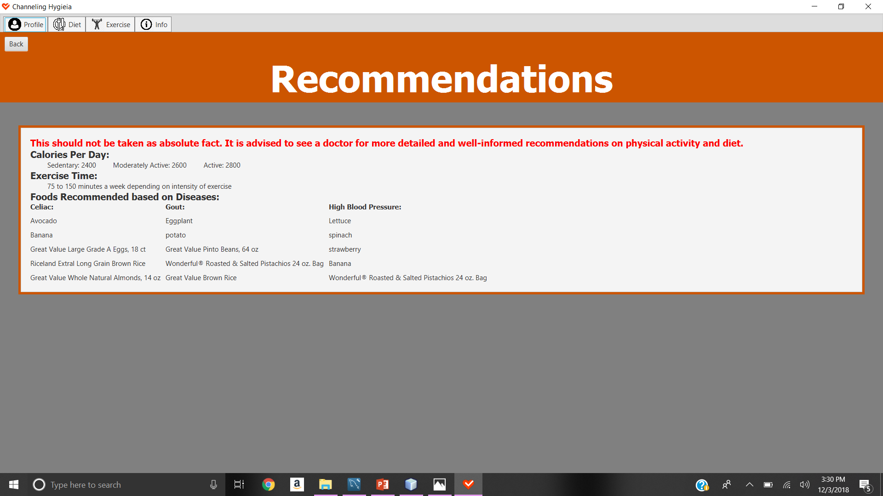
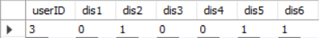
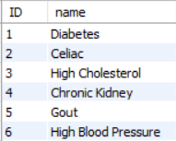




Recommendations
Nutritional
Calories per day: Gender and/or Age
Foods to eat: Diseases/Conditions
Exercise Time
Age

Slide 10
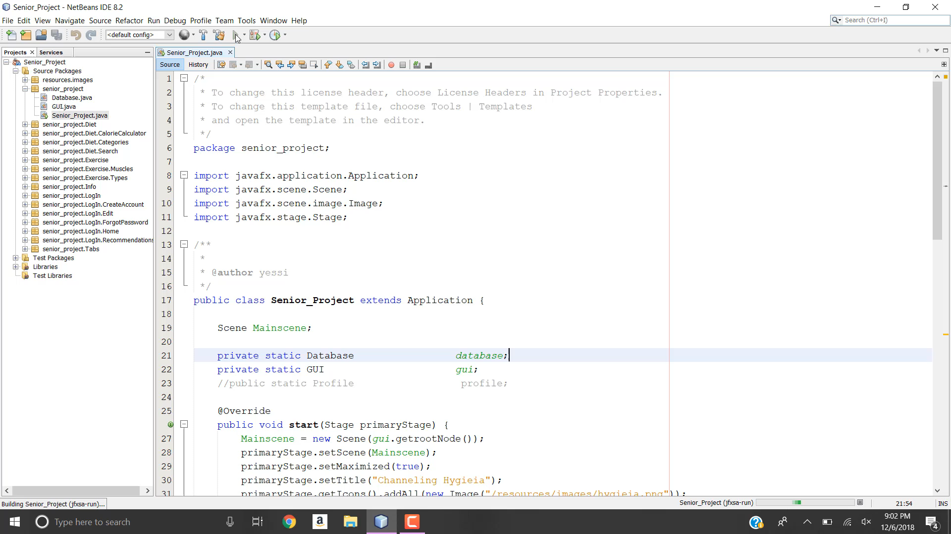
VIDEO DEMO

Slide 11
ISSUES & RECOMMENDED ENHANCEMENTS
Add more foods, exercises, allergies, and diseases/conditions to the database
Allow the user to be able to add foods or exercises to the database
Allow the user to be able to sign-out and sign-in without having to close the application
Use the users address to provide contact information on Doctors based on user’s disease/conditions or even a Dietician in the area
Add a search option for the exercises
Modify the calorie calculator to obtain the serving size based on picture

Slide 12
CONCLUSION
The user can:
View data stored in the database
Nutritional Information
By food category
By food name
Exercise Information
By exercise type
By muscles worked
User
Personal and medical information
Profile picture
Username
Enter and edit data into the database
Create New Account
Change or add personal information, medical information, and profile picture
Change password
Calculate the calories they have consumed based on the number of servings
Open in default browser websites with additional information on healthy living

Slide 13
References
[Apple made of fruits and vegetables]. (2014, August 5). Retrieved November 2, 2018, from http://www.firsttimemomanddad.com/2014/08/mom-score-i-figured-out-how-to-get.html
Fitness Centre Dumbbell Physical fitness Weight training Exercise [Silhouette lifting weights]. (n.d.). Retrieved from https://www.kisscc0.com/clipart/fitness-centre-dumbbell-physical-fitness-weight-tr-953oxp/
Frey, R. (2010, May). MVC-Process.png [Diagram of interactions within the MVC pattern.]. Retrieved November 2, 2018, from https://en.wikipedia.org/wiki/Model–view–controller#/media/File:MVC-Process.svg
Icons8 Designer Team. (n.d.). Heart Health Icon in Flat Style [Red heart with a check mark]. Retrieved November 2, 2018, from https://icons8.com/icon/19625/heart-health

